Slide 1
Bias, Fairness and Transparency
Miranda Mowbray
miranda.mowbray@bristol.ac.uk

Slide 2
With great power comes great responsibility
Notes:
Just because this was said by a cartoon character doesn’t mean it isn’t true
(It was said by Uncle Ben in the Spiderman comics)

Slide 3
Bias, fairness and transparency
Bias, unfairness
In this session, systematic unwanted outcomes for a particular demographic group
(not statistical bias or inductive bias)
Transparency
Traceability
Explainability
Communication of limitations
Notes:
Statistical bias is when your attempts to hit a target go systematically to the right. The unit programme asks whether inductive bias is always a bad thing. It isn’t. Inductive bias is the simplifications made in the model. All models are biased because they’re all simplifications of the real picture, but some are useful because their simplifications lead quickly to reasonably accurate results. So inductive bias can be a good thing.
Anyway, what I’ll be talking about in this session is demographic bias.

Slide 4
This session includes
Bias & Fairness
- COMPAS example, predictive analytics in criminal justice
- Sources of algorithmic bias
- Some references for debiasing methods
Transparency
- Transparency-related questions from Ommy and Jojo
Case study: tenant screening
Virtual office hour: email me
Slides will be available on SharePoint
Notes:
I have a virtual office hour: email me if you’d like to ask about or discuss anything in my sessions, and I’ll fix up a time to talk with you, probably by Zoom.
Thanks to all of you who suggested topics.

Slide 5
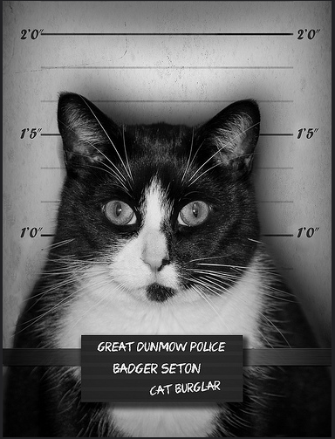

COMPAS example
Mark Seton / markseton on Flickr
https://www.flickr.com/photos/markseton/10766023213
Notes:
I’ll talk now about recidivism prediction, in which a predictive algorithm decides whether or not a convicted criminal (like this cat burgler) is at high risk of being rearrested if they’re freed on parole, so as to help a parole board decide whether they need to continue to be locked up or whether they can be released. I’ll be talking about a particular algorithm called COMPAS that is used for this in several parts of the United States. (It was designed for use in determining parole. Contrary to the designers’ wishes, it’s also been used to support sentencing in some States.)

Slide 6
Objections to this sort of algorithm
Distracts from the big issue: US incarceration rate
- One of world’s highest, 3.6 x rate for England & Wales
World Prison Brief, May 2024
https://prisonstudies.org/sites/default/files/publications/world_prison_population_list_14th_edition.pdf
Predicts re-arrest, not re-offending
marijuana possession arrests biased against Black Americans
arrests for violent crimes perhaps not
Jennifer Skeem & Christopher Lowenkamp, 2016
http://bit.ly/3uyQGqb
Notes:
Before I go into the detail, I’d like to talk about two broader-scale objections to this sort of algorithm. The first is that thinking about the design of this algorithm is a distraction from the big problem of the very high US incarceration rate. The US incarceration rate is 3.6 times as large as that for England and Wales, and England and Wales has a high rate compared to most countries in mainland Europe. My take on this objection is that just because there are big problems in the world doesn’t mean that you shouldn’t consider any small problems. But talking in general, if you’re looking an ethical issue it’s right to consider the wider ethical context. You don’t want to find yourself designing beautifully unbiased code for a company whose basic business model makes you feel queasy.
The second objection is that the data on which the code to make the prediction is trained can only come from people who have been arrested. There are reasons to believe that a Black American who commits a crime is more likely to be arrested than a White American who commits a crime, making the input data exaggerate the recidivism rate for Black Americans.
In general again, when you’re doing machine learning you should think about where your input data comes from and the extent to which you can rely on it, and whether there are things you can do to make it more reliable. It may be that the data is so bad that you want to avoid the task altogether, or limit it to particular subcases where there’s better data.
US has 6th highest incarceration rate in the world (out of countries for which there is reliable data for the number of prisoners) at 531 per 100K population. World rate is 140.

Slide 7
False negatives vs false positives
Tradeoff between false negatives and false positives
You can’t minimize both
Policy decision
More important to prevent future crime,
or prevent unnecessary incarceration?
Notes:
In predictive analytics, except in trivial cases, you can’t minimize both false negatives and false positives. In the case of recidivism prediction, false negatives mean more crimes, false positives more unnecessary incarceration. You have to choose how to weight these.
Often in predictive analysis in practice, this tradeoff is not discussed, and false positives and negatives are weighted equally. It should be discussed; it should be an informed policy choice.
In the US this choice was made with consultation with people in criminal justice, including judges, victims and offenders. The choice was to bound the false negative rate above, and minimize the false positive rate given this bound. Because there’s a tradeoff between the two, the effect of this is essentially to fix the false negative rate at the bound.

Slide 8
Scandal
Analysis of COMPAS predictions:
False positive rate for Black offenders almost double that for White offenders
Julia Angwin et al, ProPublica, 2016
http://www.propublica.org/article/machine-bias-risk-assessments-in-criminal-sentencing
Notes:
There was a scandal you may have heard about, when ProPublica revealed that its false positive rates were almost twice as high for Black offenders as for White offenders.

Slide 9


High risk Low risk
Photo of Bob and Shaggy Angus / eyesore9 on Flickr
https://www.flickr.com/photos/eyesore9/8428787607/

Slide 10
Response by company selling COMPAS
Criterion was equal precision of hi-risk predictions
Precision = p(re-arrest | high risk prediction)
False +ve rate = p(high-risk prediction | not re-arrested)
Criteria not just different – actually incompatible!
Except in cases unlikely to occur. Assumes different underlying rearrest rates, and equal false negative rates.
Notes:
Northpointe responded to the ProPublica article by pointing out that COMPAS had equal precision of high risk predictions for Black and White offenders, that is, a high-risk offenders had the same probability of being re-arrested whether they were Black or White. That was the criterion that they’d been set. As you can see, precision and false positive rate are different things. But in fact, they’re not just different, they’re actually incompatible, except in special cases that are unlikely to occur.

Slide 11
Incompatibility result
For two groups with different rearrest rates,
you can’t have:
equal precision, and
equal false positive & false negative rates
for the two groups
Policy decision
More general fairness incompatibility results:
Arvind Narayanan, “21 fairness definitions and their politics”, 2018
https://www.youtube.com/watch?v=jIXIuYdnyyk
Notes:
You have to decide whether you want equal accuracy of high risk predictions or equal misclassification rates. You can’t have both. This is a policy decision, and the fact that you have to choose comes from maths, not from poor algorithm design. If you ask for one of these you can’t complain that you don’t get the other.
And in fact, these are not the only two incompatible sets of fairness definitions. Arvind Narayanan has a paper on 21 fairness definitions used in the literature, and a lot of them are incompatible in cases likely to occur. Basically, if you regard the numbers of false positives, true positives, false negatives and true negatives as variables, there’s a limit to the number of simultaneous equations in the variables that can be satisfied, except in special cases when some of the equations are linear combinations of the others. You get one equation from the underlying recidivism rate and one from the size of the group, leaving room for just two other conditions. Arvind Narayanan shows that there are cases where even two can’t realistically be satisfied.

Slide 12
Inputs
The 137 Northpointe COMPAS inputs included
Gang member
How often do you have barely enough money to get by? (often/seldom/never)
In your neighbourhood, have some of your friends and family been crime victims?
Northpointe, “sample risk assessment – COMPAS core”
https://www.documentcloud.org/documents/2702103-Sample-Risk-Assessment-COMPAS-CORE.html
Inputs known, but algorithm is confidential
Notes:
How did the decisions differ by race? Northpointe don’t use race as an indicator – they’re not allowed to. But they do use gang membership, being poor, and having neighbourhood friends who are crime victims, all of which are more likely to happen to you in the US if you’re black.
Some methods of recidivism prediction only use gender, age, substance abuse, and criminal record. But we know that criminal records are correlated with race. Some people have suggested only using causal indicators. So here, being a gang member is a causal indicator, but being poor isn’t. The problem with limiting to causal indicators only is that sometimes we have no causal indicators at all, for instance for detecting zero-day attacks on computer networks, and sometimes the very best indicators are non-causal.

Slide 13
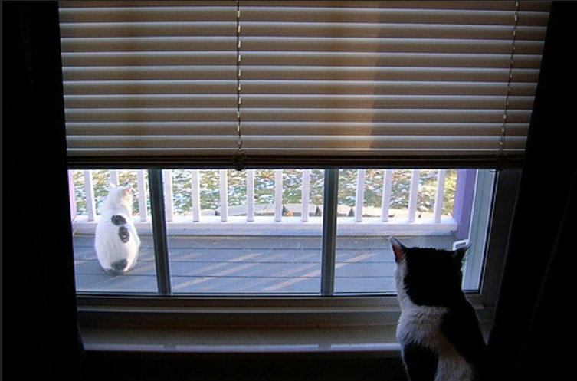
Black cat locked up, white goes ree
Maia C / maiac on Flickr
https://www.flickr.com/photos/maiac/320846855 /
Notes:
This is a black cat locked up while a white cat goes free.

Slide 14
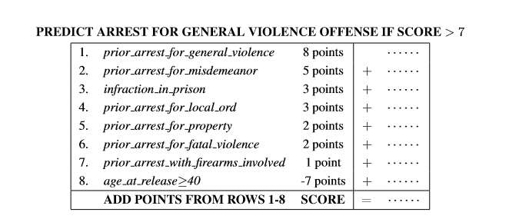
An easy-to-understand model
Derived using machine learning, for a given false negative rate
Cynthia Rudin et al, 2016, http://arxiv.org/abs/1503.07810
Notes:
Here’s an easy to understand model for predicting re-arrest for a violent offence. You have up to ten indicators, for each indicator that’s true for the defendant you score a number of points between 10 and -10, and if the total is more than a threshold the prediction is that the defendant will be re-arrested.
You can derive this model by searching over models of this type, rather than arbitrary models, there’s free open source code available to do it. You can see that it’s easy to understand, including by the defendant.
Doing this produces models of similar accuracy to searching using machine learning without understandability constraints.

Slide 15
Rudin et al’s models
- Easy to understand
- Free open-source code
More accurate than Northpointe’s COMPAS
Still not very accurate though - ROC-AUC ~ 0.72
- Cynthia Rudin et al, 2016 http://arxiv.org/abs/1503.07810
Other explainability techniques
(Shapley values, counterfactuals):
Session by Telmo de Menezes e Silva Filho
Notes:
The models that you get for recidivism prediction have better accuracy than COMPAS.
But they’re still not very accurate. Predicting whether a criminal will be rearrested just seems to be an inherently hard problem. Machine learning can’t solve all problems, for instance there may be a lot of noise in the outcome, or it may be very hard to measure some relevant factors.

Slide 16
Protected Characteristics, UK
Age
Disability
Gender reassignment
Marriage and civil partnership
Pregnancy and maternity (direct discrimination)
Race - includes e.g. “ethnic group”, skin colour, etc.
Religion or belief
Sex
Sexual orientation
UK Equality Act 2010, https://www.legislation.gov.uk/ukpga/2010/15
Notes:
The Equality Act says you can’t have a practice that puts people with a relevant protected characteristic at a particular disadvantage, unless you can show that this is a proportionate means of achieving a legitimate aim. This covers indirect as well as direct discrimination. (Pregnancy & maternity are not in the list of characteristics protected from indirect discrimination, but the rest are.)
An AI model may be biased based on non-protected characteristics. Sometimes this really isn’t problematic, for instance I think it’s fair enough to use gang membership as a feature to predict future re-arrest. Others might be more of a problem. Unfortunately it isn’t possible to detect and mitigate bias for ALL characteristics. Socioeconomic status is not a protected characteristic under UK law. For some applications it might be one that you would want to avoid bias for.

Slide 17

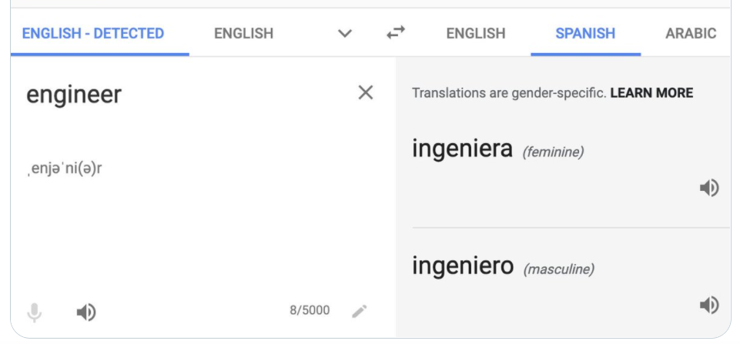

Technical tools for debiasing
Photo of Shadow with tools
Dylan Foley / shoesfullofdust on Flickr, https://www.flickr.com/photos/shoesfullofdust/3998619581
Notes:
Now I’ll tell you some other technical tools you can use for debiasing.

Slide 18
Some technical debiasing methods
Tools for debiasing structured data processing
see Vaquero, 2021 https://www.linkedin.com/pulse/fairness-ai-pros-cons-toolboxes-luis-m-vaquero/ ; e.g.AI Fairness 360, FAT Forensics
Stopping toxic text content
- RLHF (used by LLMs)
- UnBias+ Python package https://vectorinstitute.github.io/unbias-plus/
Mitigating LLM bias
prompt e.g. “ignore caste stereotypes”, in-context learning
output filtering, monitoring, audit, HITL (risk level dependent)
https://www.gov.uk/government/publications/ai-insights/ai-insights-large-language-models-llms-bias-html
Notes:
One of the toolkits Luis Vaquero recommends is FAT forensics, a python toolkit on algorithmic accountability, fairness and transparency from the University of Bristol. Peter Flach and Raul Santos-Rodriguez gave technical advice.
A system prompt to ignore caste stereotypes may help prevent direct discrimination, but from what I’ve seen I suspect it wouldn’t help with indirect discrimination.
You also need policy and governance (as I’ll say later on).

Slide 19

“a portrait of a software engineer” before mitigation after mitigation
Images output by DALL-E 2, published on OpenAI blog 18 July 2022
https://openai.com/blog/reducing-bias-and-improving-safety-in-dall-e-2/
Notes:
The state before mitigation shows bias magnification: it’s less diverse than the data for actual software engineers. Notice that the mitigation is aspirational, rather than reflecting the actual population of software engineers - it’s more diverse with regard to gender than the actual population of software engineers (but has fewer Asian software engineers). It’s perhaps based on the US population. The way that it was done is this. DALL-E 2 worked out if you were asking for a picture of a human being, and if so, added some demographic wording such as “black male” or “Asian female” invisibly to the prompt.

Slide 20
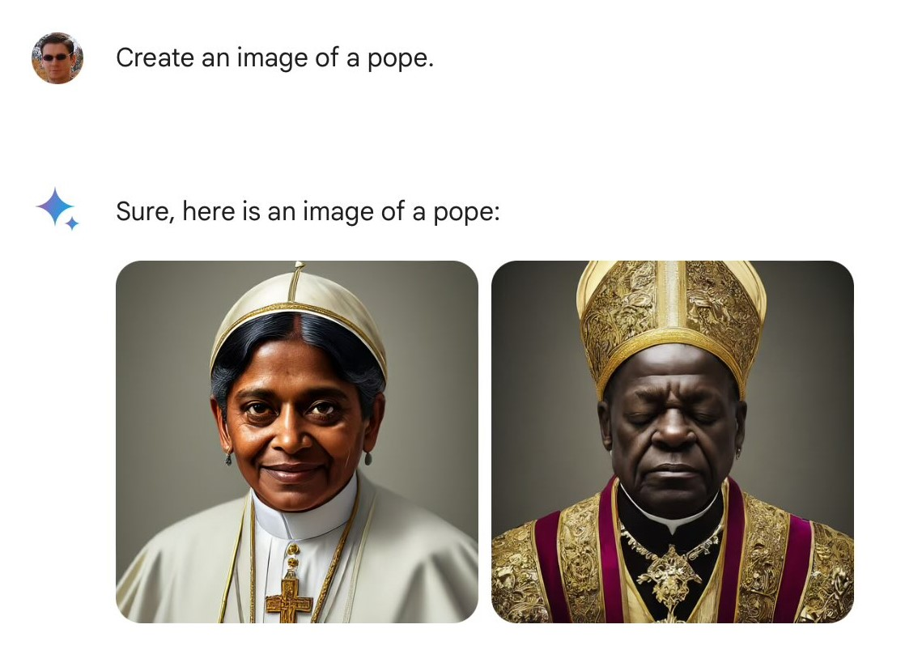
One problem with this
Images created using Google Gemini, tweeted 21 Feb 2023 by Frank J Fleming, https://x.com/IMAO_/status/1760093853430710557/photo/1
Notes:
For some applications you don’t want the generative AI to mitigate in that way. Automatically working out under what circumstances it’s appropriate to use this kind of mitigation is an unsolved problem, unless the user specifies this; so a better approach is for the user to specify what they want, rather than relying on the image generation system to do it without being told.

Slide 21


TRANSPARENCY
régia sofia / regiasofia on Flickr
https://www.flickr.com/photos/regiasofia/311369590
Notes:
The COMPAS algorithm is proprietary, and in that sense it’s not completely transparent, although we do know the input features it uses.

Slide 22
Transparency
Traceability
Document data sets and models/processes
Explainability
Clearly explain decisions to stakeholders (actionable)
Communication about limitations
Inform users of system’s purpose and limitations
Indicating it’s AI not human, where this may not be clear
High Level Strategy Group on AI, https://digital-strategy.ec.europa.eu/en/library/ethics-guidelines-trustworthy-ai
Notes:
Traceability is about tracing which data and rules were used for a particular decision (and ongoing assessment & logging)
For clear explanations, these need to be in a format understandable to the particular stakeholders. For users, the explanations should be in a form that allows users to exercise their rights, for example for correction or to contest decisions.
Also included in transparency is transparency about the business model for the system.

Slide 23
Can you tell the LLM & training data from output text? (Ommy)
Training data: generally, no
(but if you know the LLM, the provider might say?)
LLM: maybe
Watermarking, e.g. OpenAI’s textgrain, Oct 2026 https://openai.com/index/eu-text-provenance/
Statistical features (simple e.g: bigram frequency)
https://arxiv.org/pdf/1908.09203
Similarity to truncated & regenerated text
DNA-GPT https://arxiv.org/pdf/2305.17359
Notes:
This is maybe related to traceability, although really you’d want the information to be presented with the output, rather than you having to guess it from the output. The LLM used could be in metadata attached to the output text, and the training data sets indicated in the model card for the LLM.
Textgrain tweaks the probabilities of the next output token based on a secret key, and comes with a detector. Detection is less precise for shorter outputs, also after edits and synonym replacement. It’s added for ChatGPT and Codex output in the EU, & API customers globally can opt in to it.

Slide 24
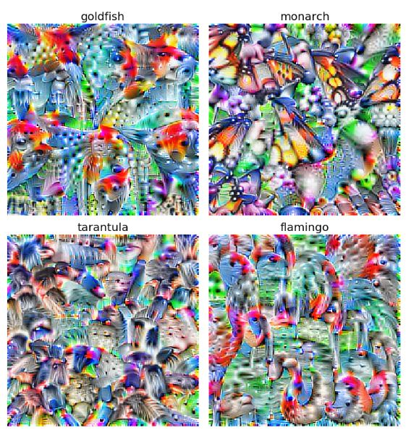
Deepdream for transparency (Jojo)
Tim Sainburg, “Visualizing classes” (cropped)
https://timsainburg.com/tensorflow-2-feature-visualization-visualizing-classes
Notes:
Jono points out this has been done for images, and asked if it’s been done for video. As far as I know it hasn’t been done for video. If you’re identifying something that can be identified from a video still I imagine you could just use the image technique, however if it’s an action that can only be identified fro a sequence of images I’m not sure how to generalize this to video – that’s a nice research problem.

Slide 25
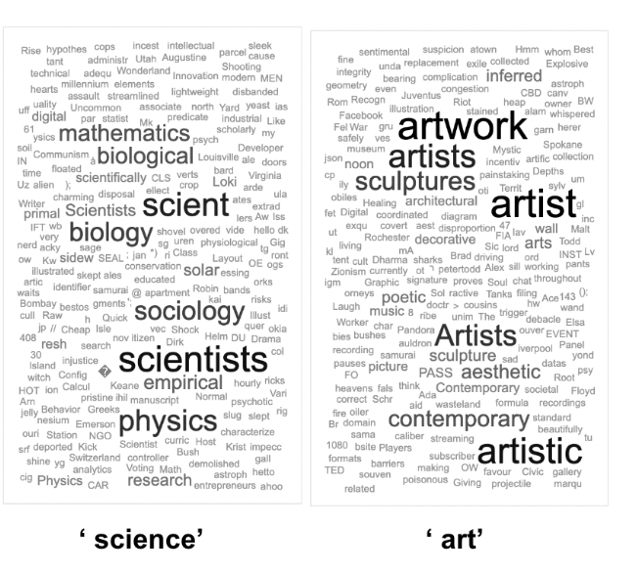
Deepdream for transparency: GPT-2
Jessica Rumbelow & mwatkins,“SolidGoldMagikarp (plus, prompt generation)”
https://www.lesswrong.com/posts/aPeJE8bSo6rAFoLqg/solidgoldmagikarp-plus-prompt-generation
Notes:
But HAS been done for text! To get this picture, you start with a random phrase or list of words and tweak the words using gradient ascent to make the next word after the phrase more likely to be “science”. You do this starting from a lot of different seeds and take a word cloud of the result.

Slide 26


CASE STUDY: TENANT SCREENING
Photo of Ritz Kirk Johnson / kaj on Flickr, https://www.flickr.com/photos/kaj64/51984570202
Notes:
This is about algorithmic tenant screening programs for landlords who want to avoid tenants who are likely to scarper without paying their rent, or who they’ll end up having to evict.

Slide 27
Tenant screening - background
Why? From survey of TransUnion customers
Eviction from about 4% of rental properties
Average cost of eviction to property owner $5,000
TransUnion’s ResidentScore
- Uses machine learning: input includes criminal record, previous tenancy disputes
- Fast, & better predictor than just using credit rating
- 0.09% with score > 720 had eviction/skip,
28.79% with score < 520
TransUnion, 2019 https://newsroom.transunion.com/property-managers-gain-greater-predictive-power-to-help-further-decrease-future-evictions/
Notes:
I’m not sure the timescale over which that 4% is measured, the TransUnion site isn’t completely clear – it might be a year, but in that case it seems a bit high – and I think it may include a “skip” tenant, that is a tenant who leaves without paying all the rent they owe. Algorithmic tenant screening is used mainly owners of a large number of properties. It’s faster than checking out a tenant by hand, and predicts eviction or skipping better than using the credit rating, which some landlords used previously.
As you can see, if you’re a landlord you probably want to avoid tenants with a score < 520. Although more than two thirds of them didn’t actually cause their landlords a problem.

Slide 28
Some sources of unwanted bias
inaccurate / unrepresentative input data
  historical & societal bias; unrepresentative sampling;
  poor proxy
- inaccurate / unrepresentative labelling
- bias magnification by some models
- bias feedback loop
gaming by users
different impact of same algorithmic outcome
Notes:
Here are some sources of bias in machine learning. For this example there’s historical/societal bias in the fact that African-Americans are more likely to have criminal records in the US. There are sampling problems, in that some of the input data used in tenant screening has been from records that were later updated, rather than the updated version, which may for example have expunged some information or recorded that a tenancy dispute was resolved in favour of the tenant. There’s a labelling issue, in the way that ambiguous records are treated; because it’s more important to landlords to avoid bad tenants than to accept applications from good ones, ambiguous records are treated pessimistically. There’s bad proxying, because rather than measuring directly the tenant’s likelihood of paying rent, for example from previous behaviour, other types of data that are less relevant may be used as proxies. Some types of model can magnify the bias in their input data – I’ve already shown you one example of that, where DALL-E 2 showed only white male software engineers. There may be bias magnification for the tenancy screening example, in that some demographic groups more likely to have criminal records are also likely than other people with criminal records to have ambiguities in these records, and ambiguities in the data tend to be treated pessimistically because it’s more important to landlords to avoid bad tenants than to accept all the good ones. There can be a feedback loop; suppose your rubbish landlord won’t carry out repairs and so you refuse to pay your rent. That causes a tenancy dispute. Your score goes down as a result, and you’ll find it more difficult than before to find a good landlord who’ll take you. I don’t think gaming by users applies to this case, but it’s something to watch out for when you think about possible ways of improving the system. Finally, getting a low score would impact groups more who already had a limited choice of possible places to rent – for instance, people who needed wheelchair access to the accommodation.

Slide 29
Tenant screening: suggestions?
Public comment by 15 State Attorneys General recommending regulations for tenant screening, 2023
Suggestions?
(Already illegal to discriminate on basis of race,
Already requirement to validate input data.
TransUnion paid $23m in 2023 to settle case.)
Notes:
Imagine you’re a State Attorney General. Do you have any suggestions?
Discrimination in housing on the basis of race is already illegal, and it’s already a requirement for tenant screening companies to validate their input data. There was also a class action case settlement of over $2m by a company called SafeRent in 2024.

Slide 30
Tenant screening recommendations
- Some types of input data not allowed
Rejected tenant gets free copy of report, and right to challenge decision
Main reasons given for rejection (which data points)
If tenant shows that decision was wrong, e.g. by proof of previous rent payments, gets offered next similar vacancy
Consumer Financial Protection Bureau gets sufficient info to audit for bias, including source code & coders’ notes.
(more) - see Attorneys General, 2023, http://tinyurl.com/5fyxvj6u
UK/EU: can have explanation of “logic” of automated decision, and human review
Notes:
These are some of the recommendations made by State attorneys general for regulating tenant screening.
They suggest for instance that data related to tenancy disputes that were resolved in favour of the tenant shouldn’t be allowed. Existing law says that the screening companies have to validate the data they use, so they’d have to check whether there had been updates and also validate ambiguous data rather than just assume the worst.
“Showing that the decision was wrong” means providing evidence that a reasonable person would think meant the decision was wrong. It might be showing that the data point that was the main reason for the rejection was incorrect, or it might be showing proof of previous rent payments.
In the UK or Europe, tenants could ask for an explanation of the “logic” of the automated tenant screening; however, the explanation might be “we use criminal records and documents relating to tenancy disputes” rather than pointing to the actual main document. UK or EU tenants could also ask for a human being to review the decision.
Taking a wider view, these recommendations are about increasing transparency; improving the ease of mitigation; providing a way to break out of a feedback loop; and improving input data quality.
A previous cohort suggested having a landlord screening tool to help prospective tenants avoid rubbish landlords.
Stan said, looking at the wider context, that to avoid there being a set of people who can’t get housing at all if this kind of algorithm is widely used, there should be a right to housing.

Slide 31
AI fairness isn’t just about debiasing models & data
which fairness criterion?
processes for discovering problems/inaccuracies
mitigation or remediation
accountability
Transparency can help
Policy & governance, not just tech
Notes:
Algorithmic fairness isn’t just about debiasing models and data. You also need policy and governance. If there’s just one slide I’d like you to remember from this session, it’s this one.

Slide 32
Bias, Fairness and Transparency -
Virtual office hour: email me
Miranda Mowbray
miranda.mowbray@bristol.ac.uk
Spring session: privacy, & what you can do

